Slide 1

File Operations
Prof. Dr. Alp KUT
Asst. Prof. Dr. Derya BİRANT

Slide 2
OUTLINE
File Operations
List of File Operations
Opening / Closing a File
Reading from a File
Writing into a File
End of File (EOF)
Examples

Slide 3
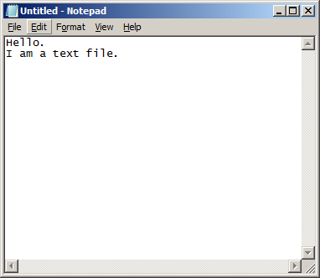
File Operations
File Operations are the different things that can be done to a computer file.
Basic file operations:
  opening / closing a file,
  writing data to a file,
  reading data from a file,
  deleting a file,
  etc.,

Slide 4
File Operations in C#
All I/O (Input/Output) operations in C# are under System.IO
System.IO must be included before writing your programs as the following:
using System.IO;

Slide 5
File Operations in C#
Opening a File
Operation | Detail
File.CreateText(string path) | Creates or opens the file in the path to write.
File.AppendText(string path) | Opens the file in the path to append new text.
File.OpenText(string path) | Opens the file in the path to read.
Closing a File
StreamWriter.Close() | Closes the stream.

Slide 6
File Operations in C#
Writing into a File
Operation | Detail
StreamWriter.Write(string value) | Writes value into the file.
StreamWriter.WriteLine(string value) | Writes value to the current line and jump the new line.
Reading from a File
Operation | Detail
StreamReader.Read() | Reads the next character from the input stream.
StreamReader.ReadLine() | Reads a line of characters from the current stream and returns the data as a string.
StreamReader.EndOfStream() | Indicates whether the current stream position is at the end of the stream.

Slide 7
Stream
A stream is an abstraction on which input and output operations are performed.
StreamReader is used for reading data from a standard text file.
StreamWriter is used for writing data into a standard text file.

Slide 8
File Open
CreateText: File is created and opened for writing.
StreamWriter f = File.CreateText("c:\\MyTextFile.txt");
………… // Writing operation is done here
f.Close();
OpenText : An existing file is opened for reading
StreamReader f = File.OpenText("c:\\MyTextFile.txt");
………… // Reading operation is done here
f.Close();
AppendText: An existing file is opened to append a text.
StreamWriter f = File.AppendText("c:\\MyTextFile.txt");
………… // Appending operation is done here
f.Close();

Slide 9
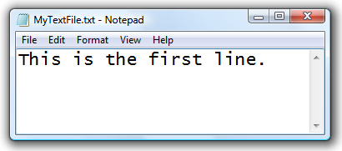
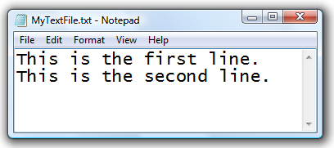
Write into a File
Example 1:
StreamWriter f = File.CreateText("c:\\MyTextFile.txt");
f.Write("This is ");
f.Write("the first line.");
f.Close();
Example 2:
StreamWriter f = File.CreateText("c:\\MyTextFile.txt");
f.Write("This is ");
f.WriteLine("the first line.");
f.WriteLine("This is the second line.");
f.Close();

Slide 10
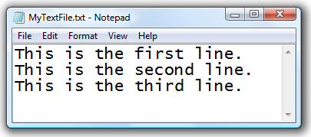
Write into a File
Example 3:
StreamWriter f = File.AppendText("c:\\MyTextFile.txt");
f.WriteLine("This is the third line.");
f.Close();

Slide 11
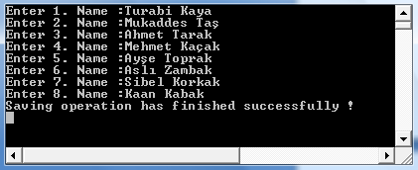
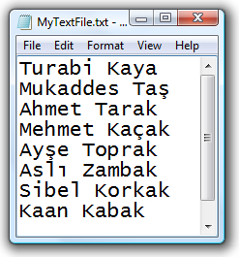
Example
Write a program that writes 8 given names into a text file line by line.
String name;
StreamWriter f = File.CreateText("c:\\MyTextFile.txt");
for (int i = 1; i<= 8 ; i++)
{
Console.Write("Enter " + i + ". Name :" );
name = Console.ReadLine();
f.WriteLine(name);
}
Console.WriteLine("Saving operation has finished successfully !" );
f.Close();

Slide 12
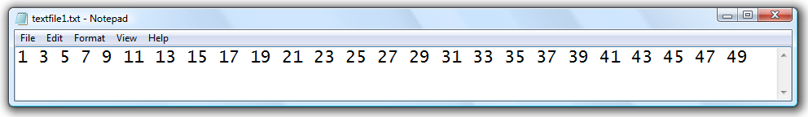
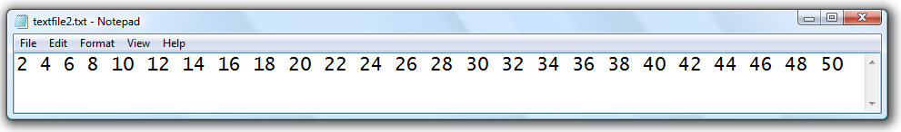
Example
Write a program that writes odd numbers into textfile1.txt, even numbers into textfile2.txt.
(Numbers are between 1 and 50. Writing operation will be done on the same line)
StreamWriter f1 = File.CreateText("c:\\textfile1.txt");
StreamWriter f2 = File.CreateText("c:\\textfile2.txt");
for (int i = 1; i<= 50 ; i++)
{
if (i % 2 == 1)
f1.Write(i + " ");
else
f2.Write(i + " ");
}
Console.WriteLine("Writing operation has finished successfully !" );
f1.Close();
f2.Close();

Slide 13
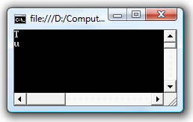
Read from a File
Example 1:
char chr;
StreamReader f = File.OpenText("c:\\MyTextFile.txt");
chr = Convert.ToChar(f.Read()); //Reads the first character
Console.WriteLine(chr);
chr = Convert.ToChar(f.Read()); //Reads the second character
Console.WriteLine(chr);
f.Close();

Slide 14
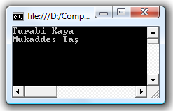
Read from a File
Example 2:
string str;
StreamReader f = File.OpenText("c:\\MyTextFile.txt");
str = f.ReadLine(); //Reads the first line
Console.WriteLine(str);
str = f.ReadLine(); //Reads the second line
Console.WriteLine(str);
f.Close();

Slide 15
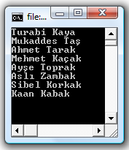
End of File
EndOfStream returns true when the end of file is reached.
Otherwise false.
Example :
string str;
StreamReader f = File.OpenText("c:\\MyTextFile.txt");
do{
str = f.ReadLine();
Console.WriteLine(str);
} while (!f.EndOfStream);
f.Close();

Slide 16
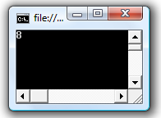
Example
Write a program that finds “how many lines are there in the file MyTextFile.txt “
string str;
int counter = 0;
StreamReader f = File.OpenText("c:\\MyTextFile.txt");
do{
str = f.ReadLine();
counter++;
} while (!f.EndOfStream);
Console.WriteLine(counter);
f.Close();

